Slide 1
Basic Data Cleaning
Original Data: (downloaded at https://datasets.imdbws.com)
title.basics.tsv.gz (tconst, titleType, startYear, genres)
title.ratings.tsv.gz (tconst, averageRating, numVotes)
title.akas.tsv.gz (TODO)
Use pandas.DataFrame.apply and filter functions to find all the movies before 2019
Merge with ratings, and compute popularity (averageRating * numVotes) for each movie
Basics: 5687200 x 9 Ratings: 914862 x 3
Movies: 450481 x 4 (tconst, startYear, genres, Popularity)

Slide 2
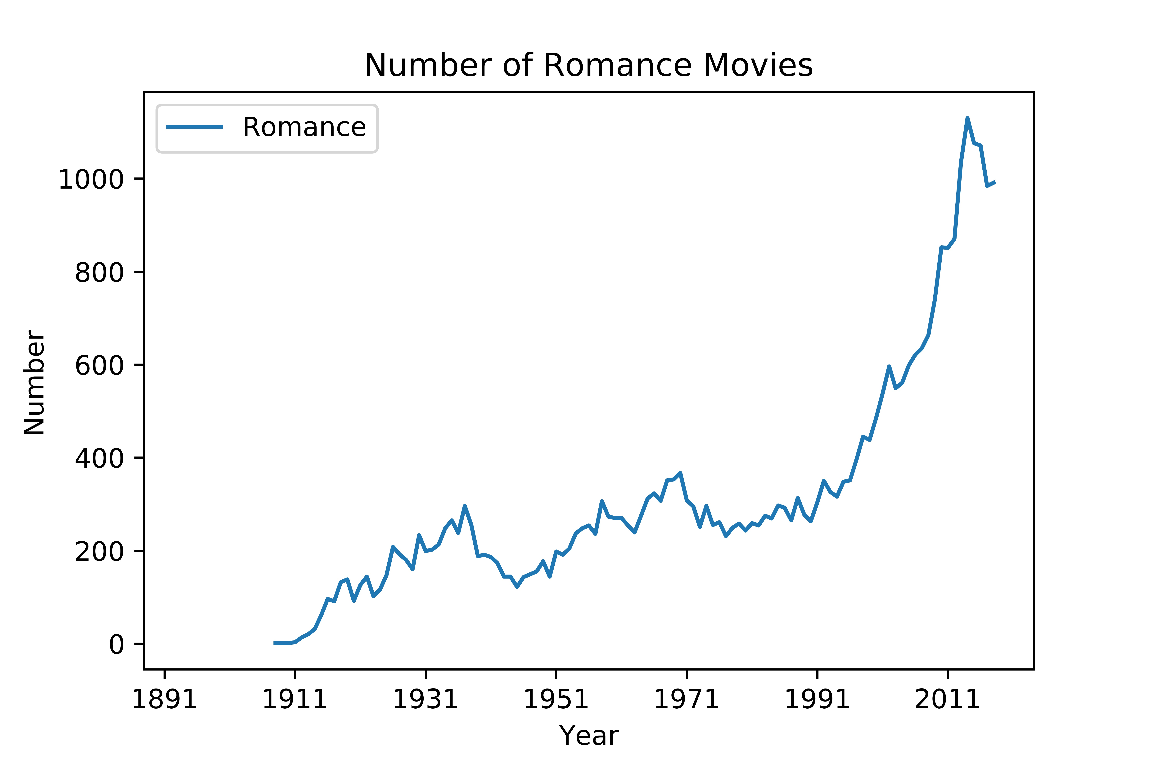
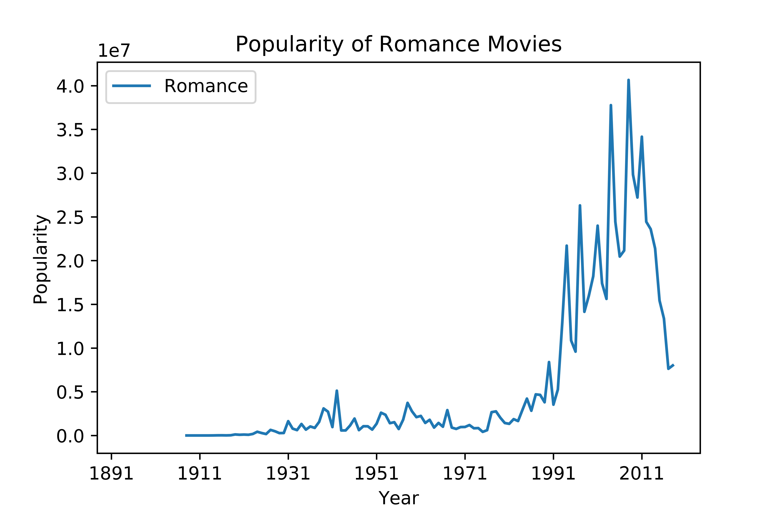
Data Aggregation
Goal: IMDB user preference on movie genres over time
Use count() and sum() in pandas.DataFrame.groupby on ‘startYear’
Use df.apply and filter functions to find specific genre
Two Measurements: total number and popularity

Slide 3
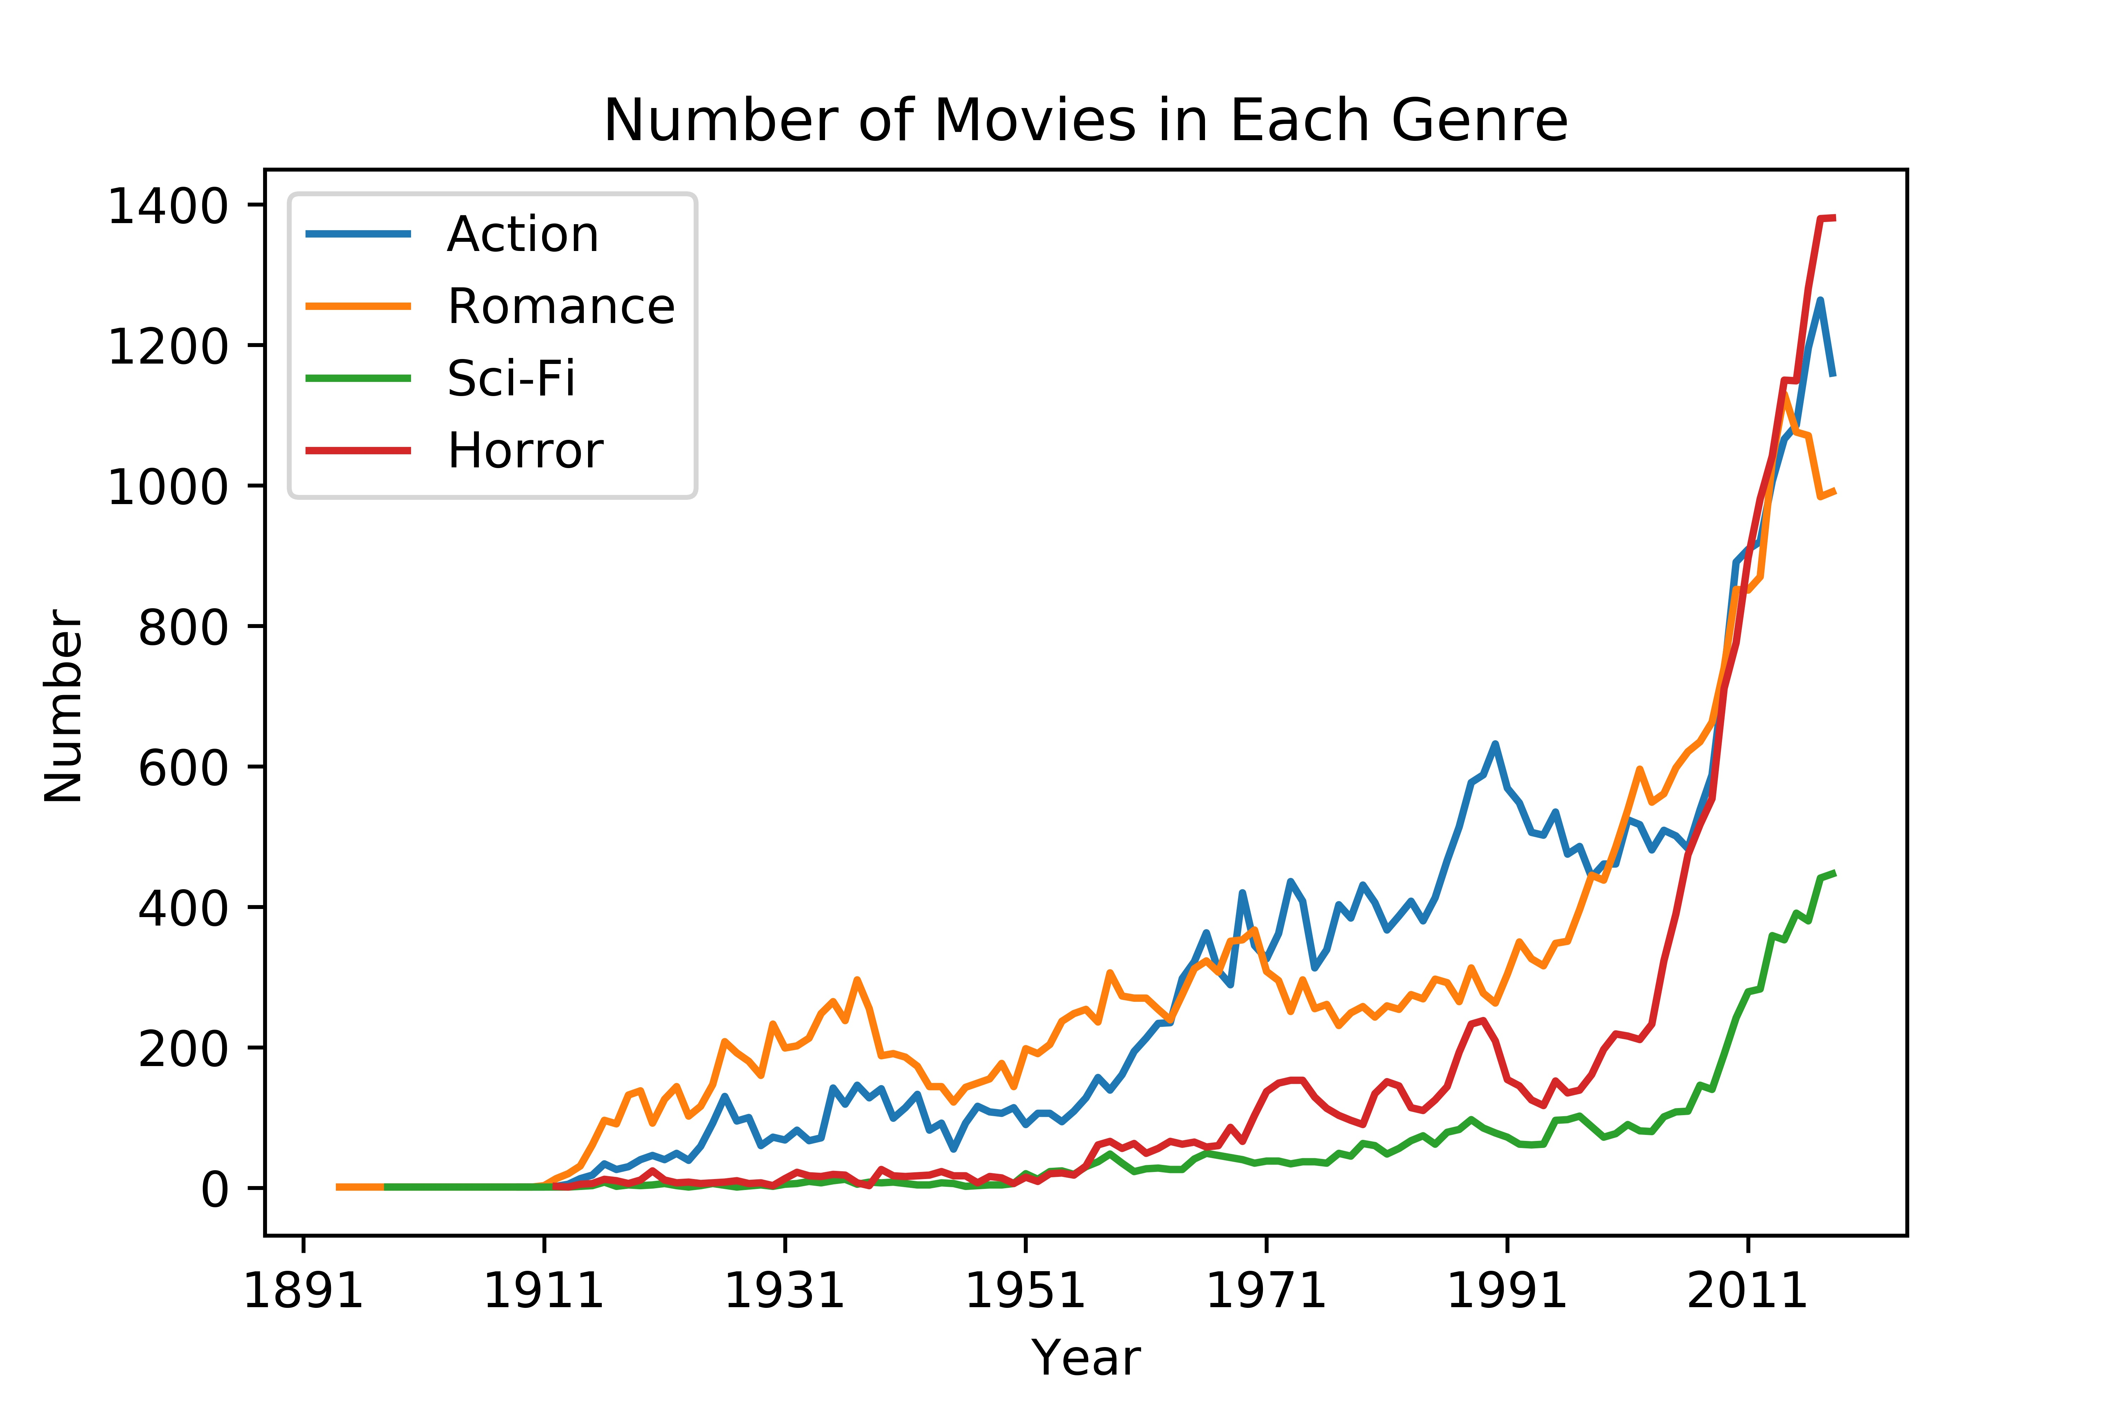
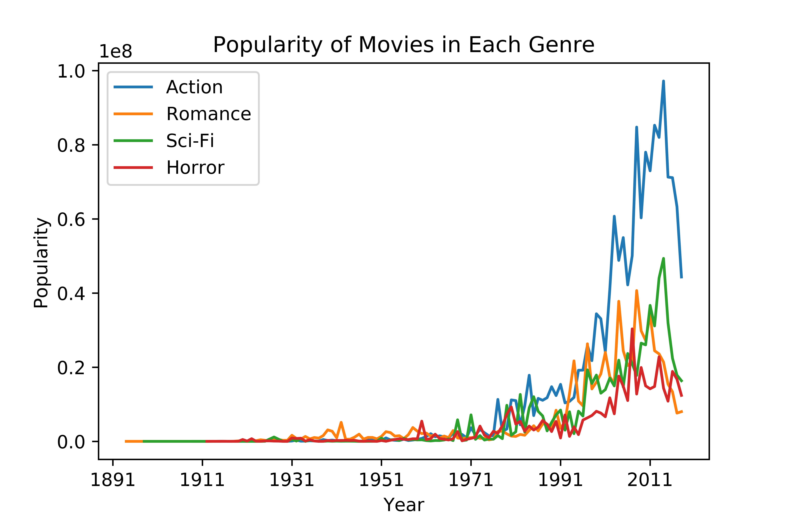
Genre Comparison
Four genres: Romance, Action, Science Fiction, Horror

Slide 4
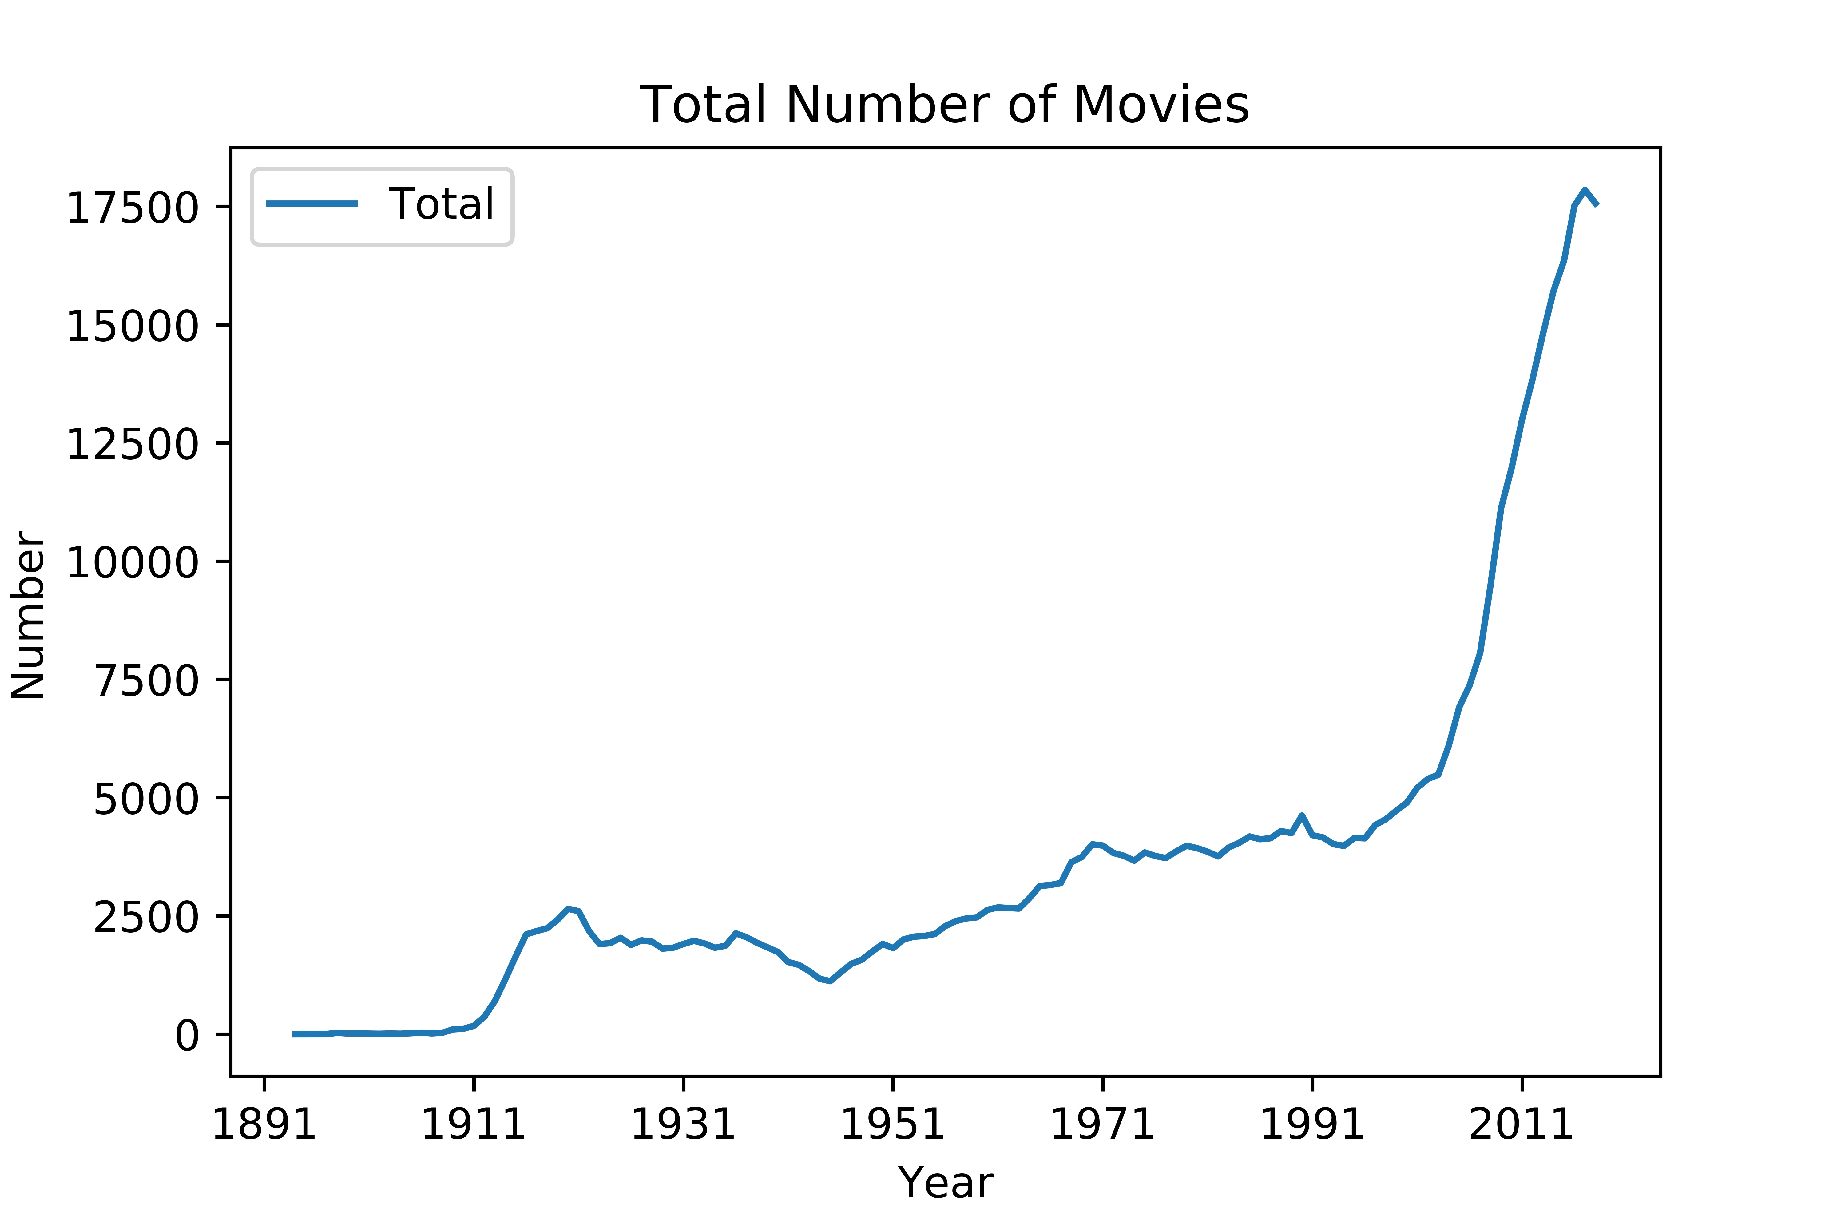
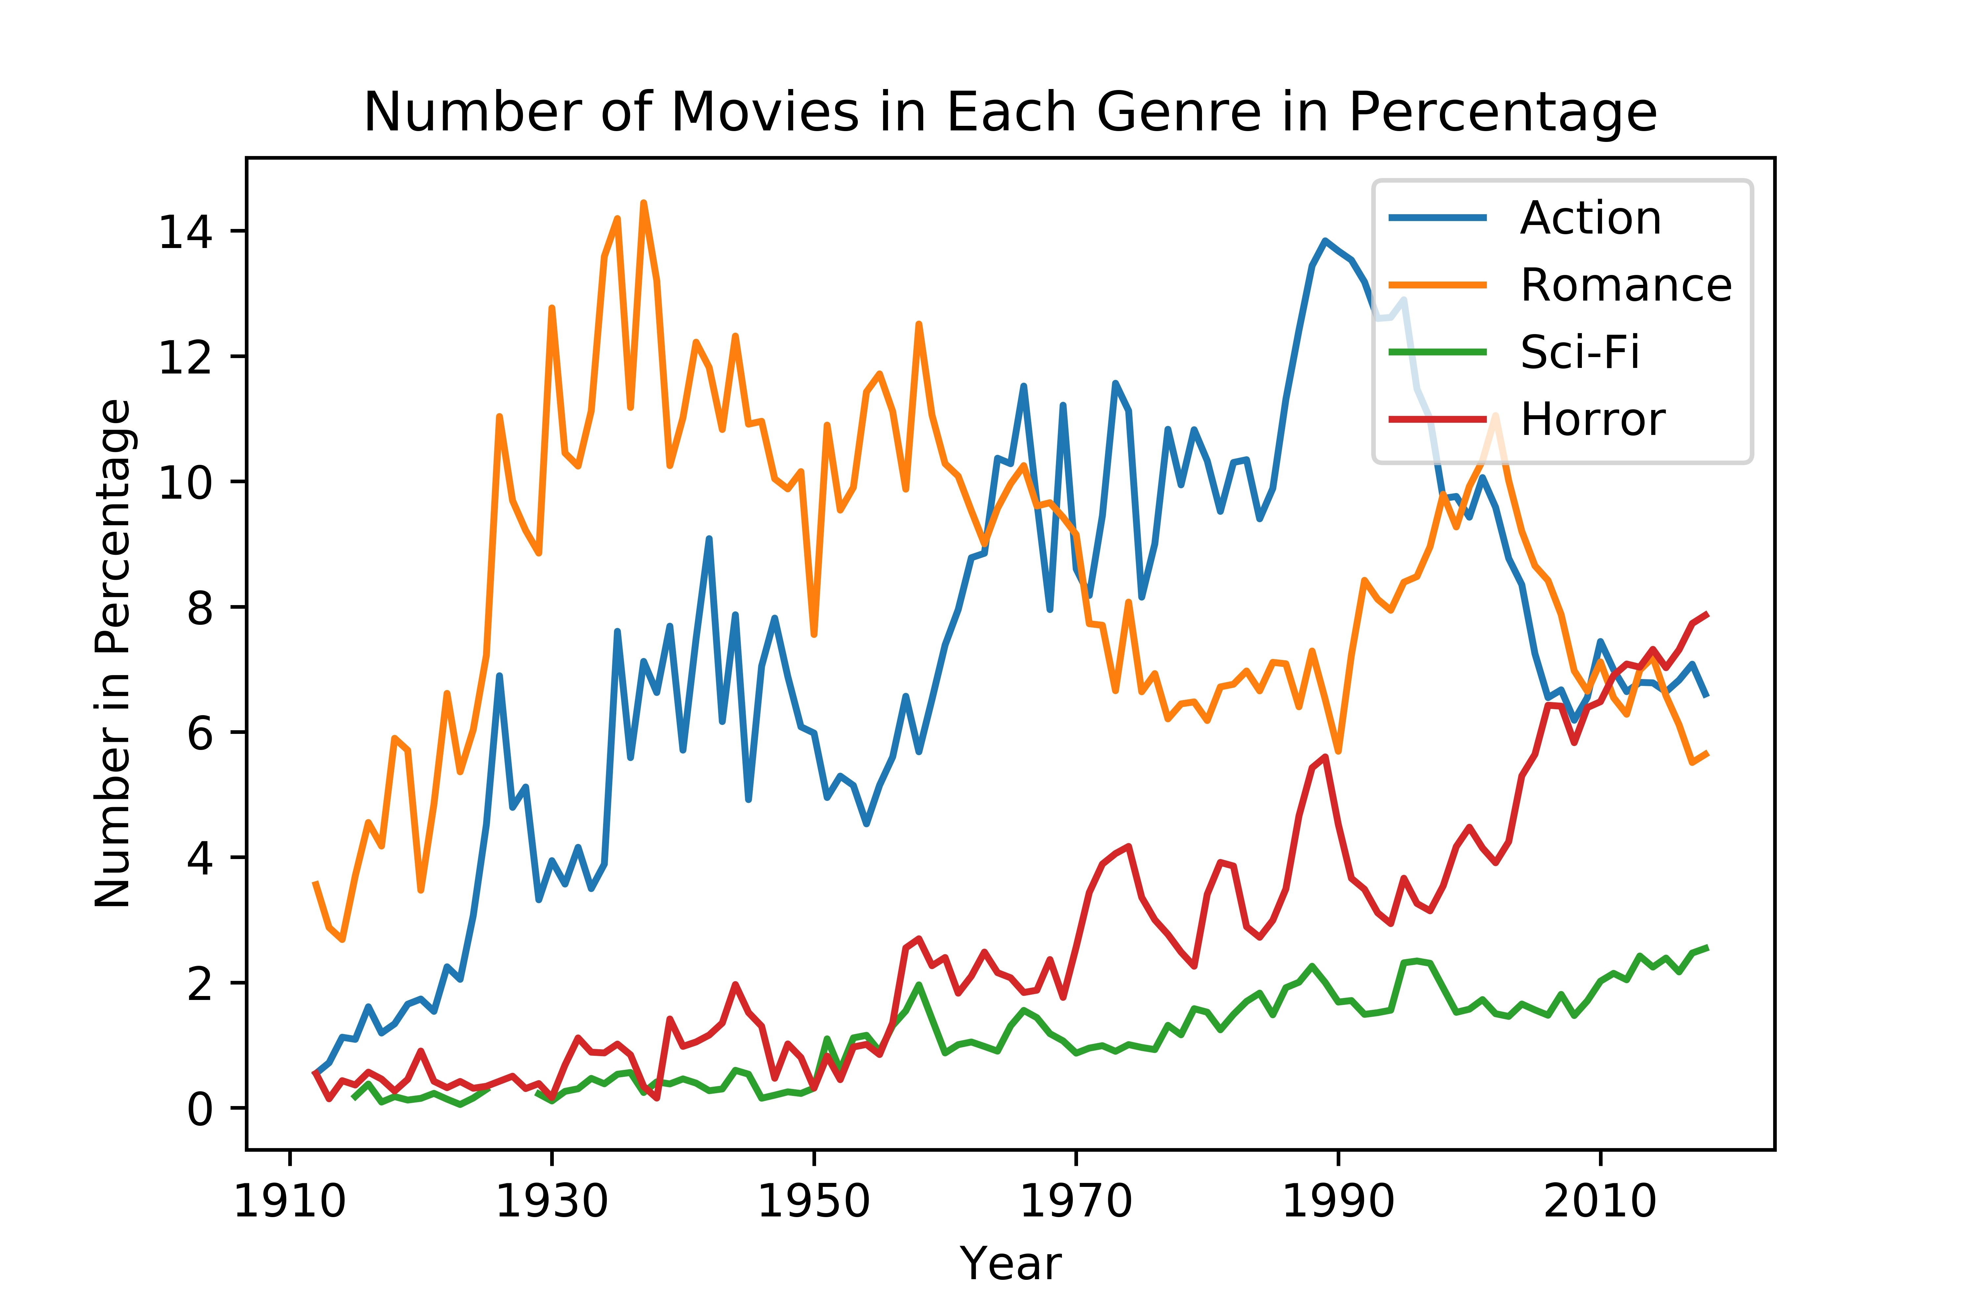
Regularization
Problem: The movie industry is growing itself
Solution: Take percentage on movie numbers (# of movies in a genre / # of movies )

Slide 5
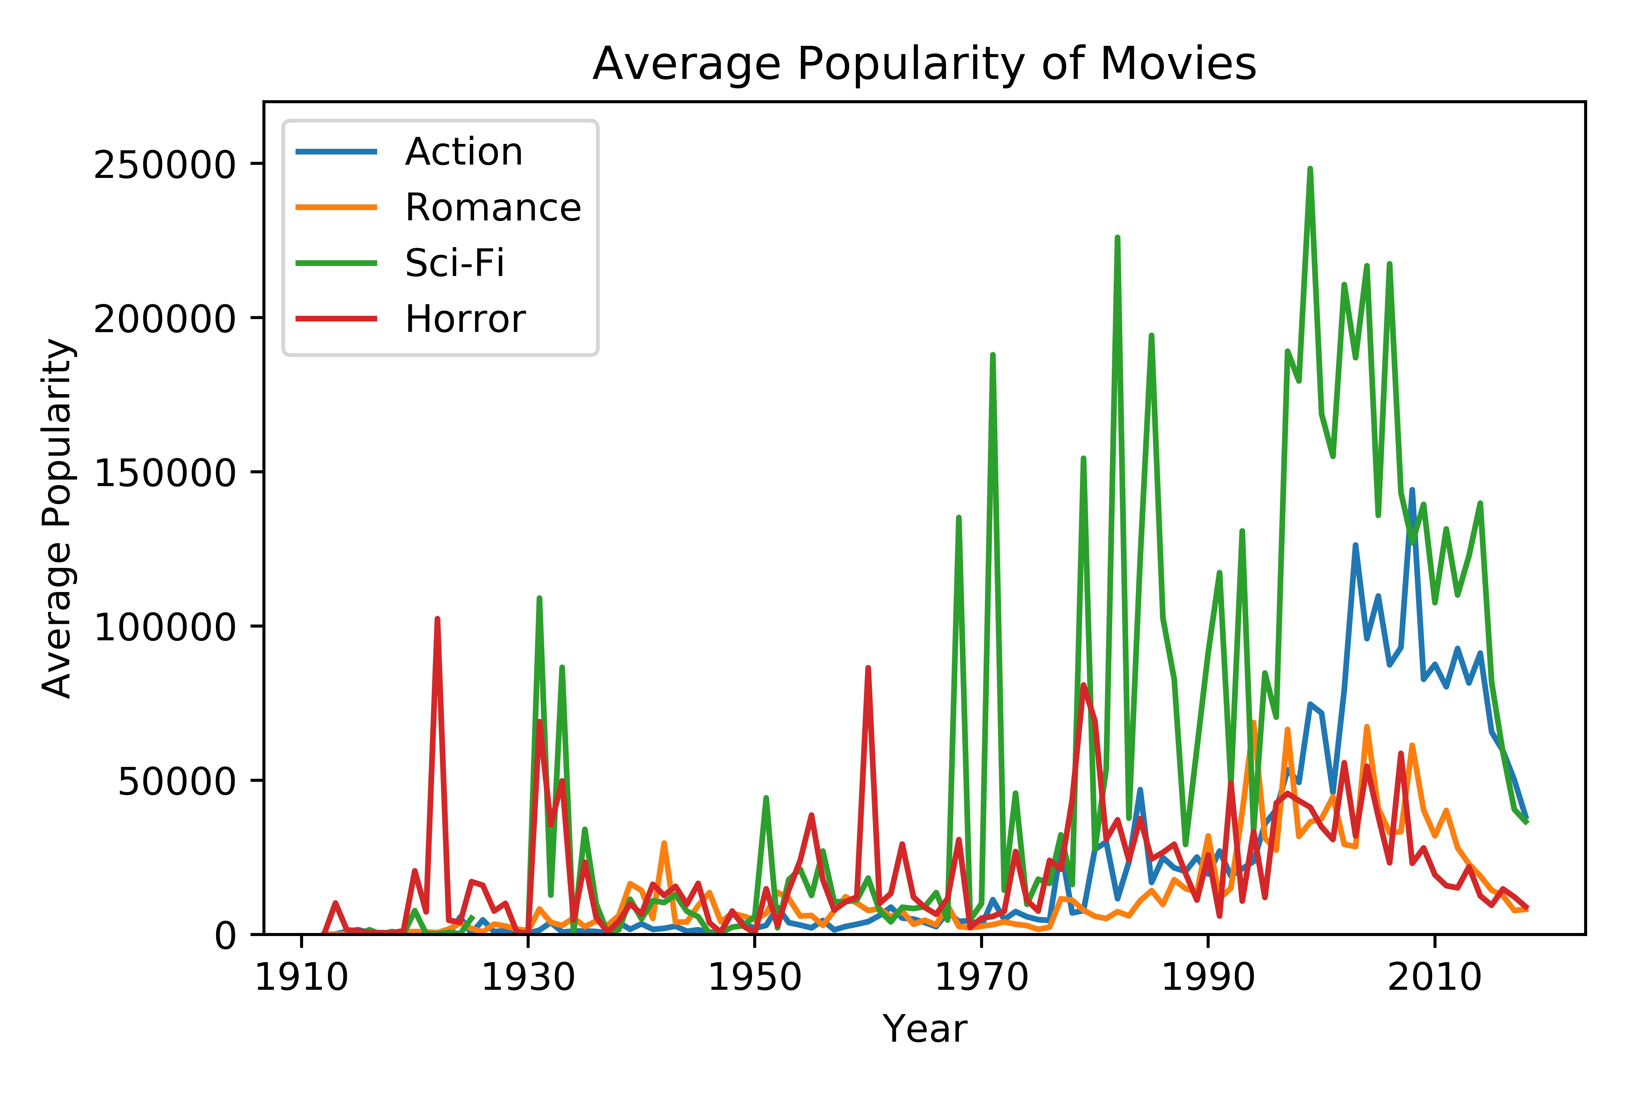
Regularization
Problem: More movies, higher popularity
Solution: Take average (genre popularity / # of movies in that genre )

Slide 6
Findings
Romance movies are more popular back in the old days
People switch their tastes to action movies
Producers makes less and less romance and action movies in recent ten years
Producers starts to make more horror movies. However, they are not as appreciated as other genres.
Producers make less science fiction movies, but people love the existing ones

